Slide 1
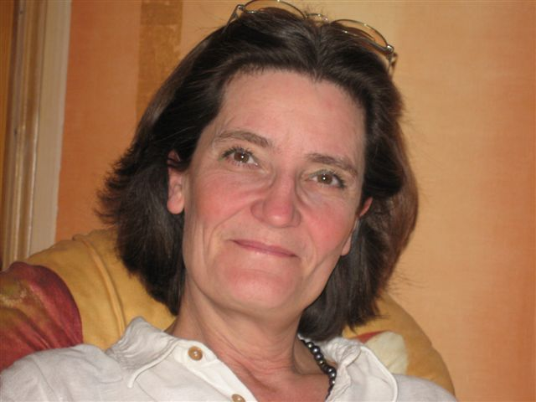
Elizabeth Englundh
Socionom, Fil. Dr i pedagogik
Sveriges Kommuner och Landsting elizabeth.englundh@skl.se

Slide 2
Who is entitled to human rights?

Slide 3
Rights - duties

Slide 4

Children are human beings, therefore they are entitled to human rights

Slide 5
Human rights
Human beings
Human rights
Men, Women, Children
Universal Declaration of Human Rights
Civil and political rights
Economic, social and cultural rights
Women´s rights
Children´s rights
Rights for persons with disabilities
Grounds of discrimination
Perpective
Age
Sex
Disability
Ethnicity
Religion or other belief
Sexual orientation
Gender identity or gender expression
Public health
Diversity
Sustainability
Agenda 2030
Aspects of
Human beings
Aspects of public organizations

Slide 6
Why?
UN
The Swedish Government
Convention
Declaration
Incorporation 2020 (Finland, 1990; Norway, 2003; Iceland?)
The Vienna convention on the law of Treaties – articel 27
National strategi 1998, 2010

Slide 7
Affordance
Possibility, act according to the CRC, intrinsic motivation
CRC
”This has no bearing
on us”
”There is no need
for this issue”
Organization, no action
Bureaucracy, Stand-by, extrinsic motivation
”This is what we already do”
Children, no action

Slide 8
Implementation Knowledge processes
Practice
Tools Methods

Slide 9
Kunskap - knowledge
”Ja, då måste man ju känna till alltihop om man ska kunna föra ut den i verksamheten. … Nu tror ju jag, som jag har sagt, att vi gör mycket av det här för att vi är så barninriktade och är så medvetna om barns villkor och rättigheter. /…/ Jag tror ju att de flesta av oss kan det här i princip, men inte i grunden”. (Förvaltningschef)
“Well, then you have to know all about it if you are to implement it in your organization. However, I think, as I have said before, that we already do a lot of this because we aim at children and are so well aware of children´s conditions and rights. I think most of us know about this in principle, but not completely”. (Administration director)

Slide 10

Three legs
Child perspective
Children´s rights
Competences
Barnsyn
Rätti
Kompetens
Perspektiv

Slide 11
Definition of a Child rights approach
That every child is recognized, respected and protected as a rights holder and as a unique and valuable human being with an individual personality, distinct needs, interests and privacy.
General comment 13

Slide 12
Barnrättsbaserat synsätt
Ett barnrättsbaserat synsätt kräver att varje barn erkänns, respekteras och skyddas som rättighetsbärare med en individuell personlighet, egna behov och intressen samt personlig integritet.
(Barnrättighetsutredningen, sid 286)

Slide 13
Självständiga barn, independent children
Barnets rättigheter, children´s rights
Kompetenta barn, children are competent
Resilienta barn, resilient children
Medborgare/invånare – kund, children as citizens or customers
Diagnosticering, diagnosis
Ansvar för sitt eget lärande, responsibility
Disciplinering, disciplining
Time – out

Slide 14
Children are primarily children?
Unaccompanied children
Vulnerabe children
Disabled children
Swedish children
Children seeking asylum
Children living i vulnerable situations
Children with disabilities
Children in Sweden

Slide 15
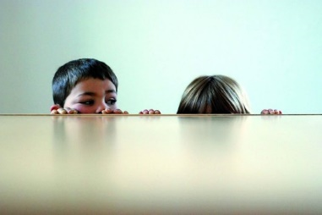
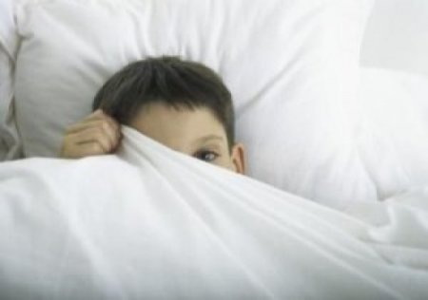
When I say child perspective, I mean …

Slide 16
S
O
S
S

Slide 17
Preschool, school
The Child
Social services
Health care

Slide 18
Preschool
School
The Child
and the question
Social services
The Child
Health care

Slide 19
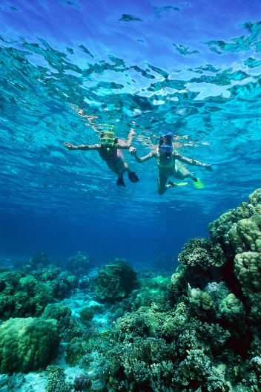

Perspective
Child perspective The Child´s Perspective
Adult´s views on children The child´s perception
Child rights perspective
Article 2, 3.1, 6, 12

Slide 20
The CRC
  Inledning (preamble)
  54 articles
  4 main principles (art 2, 3, 6, 12)
  3 implementation articles (art 4, 42, 44:6)
  13 articles about the monitoring system and how to join the crc
Notes:
20

Slide 21

Who is a child?
CRC – Article 1
“… a child means every human being below the age of eighteen years unless under the law applicable to the child, majority is attained earlier.”
GC – 7 Implementing child rights in early childhood
Up to 8 years

Slide 22

General principals
FN:S KONVENTION OM BARNETS RÄTTIGHETER
Article 2
Non discrimination
Article 3
The best interests
of the cild
Article 6
The right to life, survival and development
Article 12
The right to
be heard
Notes:
22

Slide 23
Article 2 – non discrimination
States Parties shall:
“respect and ensure” all the rights in the Convention to all children in their jurisdiction without discrimination of any kind.

Slide 24

2 – The Committee´s Comments
Interrelated to all other rights in the convention
Visible in legislation
Strategic planning
Awareness raising, education, information
Challenged in Courts
Identify the most vulnerable and disadvantaged children
Follow changes

Slide 25
For the youngest children
Girls
Children with disabilities
Ethnic origin
Class
Parents

Slide 26
Article 3.1
The Best Interests of the Child
Reflected in legislation
Every child and every decision
The individual child, children as a group and children in general
Active consideration
Can not overtrump another right
Notes:
26

Slide 27

Article 3.1
Assess the Best Interests of the Child
National law
The rights in the CRC
Current reserch
Practise
Proven experiencs
The views the Social network
Children´s views
Notes:
27

Slide 28
For the youngest children
including in articles 9, 18, 20 and 21
reliant on responsible authorities
measures to support and assist parents and others

Slide 29
Barnets bästa - The best interests of the child
”Men ofta är det så att vi fattar beslut utan att ägna det den minsta lilla tanke om jag ska vara riktigt ärlig.”
(Politiker)
“To be honest, we often decide without considering the best interests of the child, at all.”
(Politician)

Slide 30

Article 6
The inherent right to life, survival and development
The inherent right to life
Increase the expectations on life through efforts against famine and epidemics
Survival and development
The Childs life today has a value of its own it is not a
transportation to adulthood

Slide 31

6 – Holistic concept, cooperation
Abortion
Euthanasia (Holland, Belgien)
Infanticid (girls)
Early marriage (girls)
Infant mortality
The death penalty
Armed conflict
Honorkillings
Child sacrifice (born in a breach position)
Suicide
Traffic accidents
Other harmful traditional practices (female mutilation)

Slide 32
For the youngest children
Arts. 24, 27, 28, 29 and 31.
Respect for the responsibilities of parents and the provision of assistance and quality services (arts. 5 and 18).
From an early age, children should themselves be included in activities promoting good nutrition and a healthy and disease‑preventing lifestyle.

Slide 33
Article 31 – the right to rest, leisure and play
Through play children both enjoy and challenge their current capacities, wether they are playing alone or with others.

Slide 34
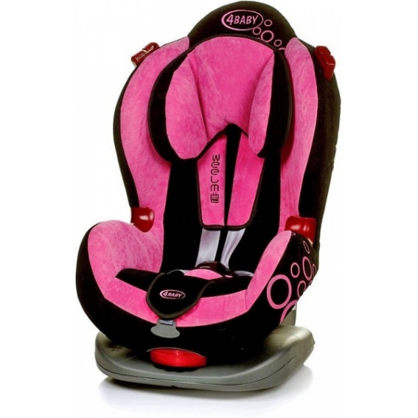
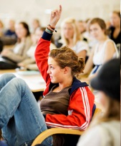
Protection - participation

Slide 35
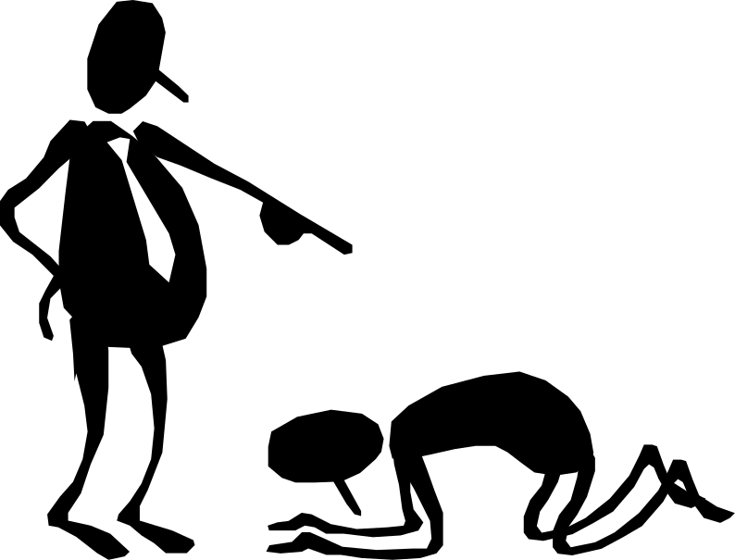
Article 12
The right to express a view freely
A civil and political right
All decisions and all children
Could be done through a representative or an appropriate body
Age and maturity
Not self-determination
No obligation
Notes:
35

Slide 36
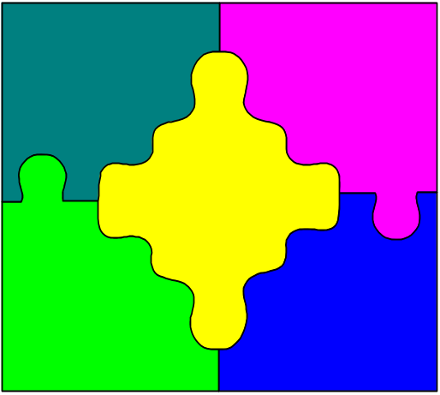
12 – Participation
Visible in legislation
Methods for children´s participation
Education for all
Listen to and give due weight
Participation without discrimination
Adults are responsible

Slide 37
Article 12
Questions to be answered
Why are we doing this?
What do we want to achive?
What children?
What questions?
How do the children express themselves?
How will the results be used?
How are the children shown respect?
What do you do if the child doesn´t think like you?
Parent´s rights vs children´s rights?

Slide 38
For the youngest children
The right to express views and feelings should be anchored in the child’s daily life at home and in his or her community; within the full range of early childhood health, care and education facilities

Slide 39
Kommunication
Are we talking to children
or
Are we talking with children
Notes:
As an adult I must always reconsider how I speak to children.
Am I talking to or with children?
Of course we do both, but it is importent to know when I do what and why.
In Sweden adults often say that the have a dialogue whit children, but if you ask children they say that adults never listen to them.

Slide 40

All communication is on the recipient's terms

Slide 41
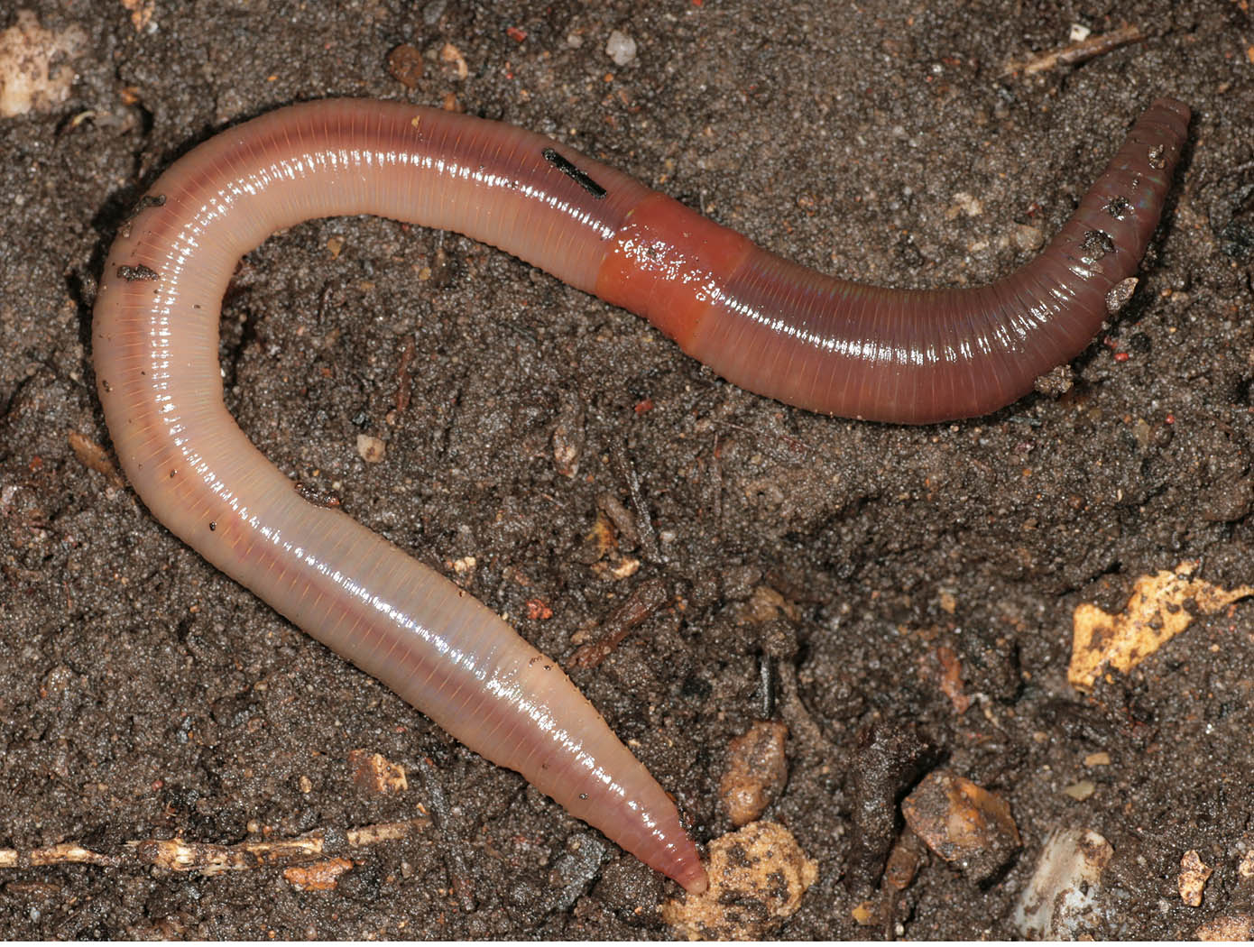
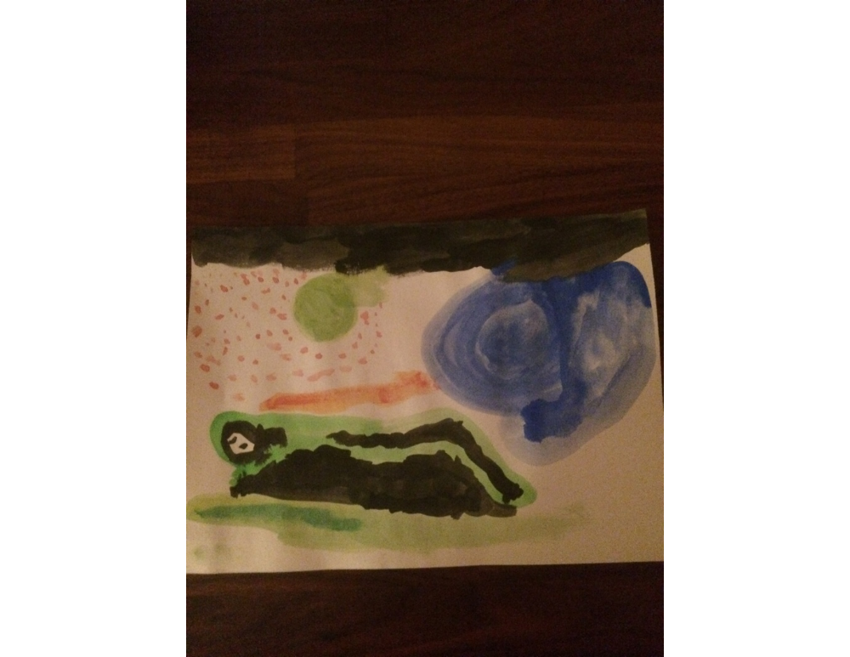

Slide 42
General implementation
Article 4
Article 42
Measures for implementation
Article 44.6
Knowledge
Reports

Slide 43
The Political Dimension
International
national
regional
local
The Legal Dimension
The status of the CRC in national legislation
The Pedagogical Dimension
How we practice the CRC, methods and tools
CRC
The Ethical Dimension
Shows how the society regard the child as a rights holders

Slide 44
Ideologi - ideology
”Jag ser ju mer på de stackars barnen utomlands i vissa länder. Det är väl där jag tycker det är viktigast.” (Politiker)
“I think about the poor children abroad, in some countries. That´s where I think it’s most important.” (Politician)

Slide 45
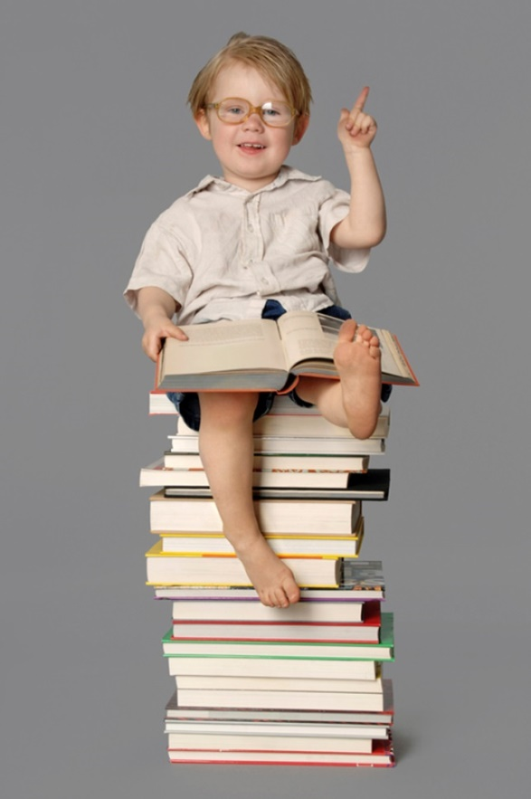
Knowledge processes
Collecting data
Article 2
Knowledge/
Information
Article 42
The best interests
of the child
Article 3.1
You and your operation
Participation
Article 12
Prioritizing
children
Article 4
Cooperation
Article 6
Notes:
My recommendation to you is to start by asking the organization if it has enough knowledge about children´s rights to practice them at all levels.

Slide 46
Data-
insamling
artikel 2
Kunskapsprocesser
Barnets
bästa
artikel 3
Information
artikel 42
Du/din
verksamhet
Inflytande
artikel 12
Aktiva
priorite-
ringar
artikel 4
Helhetssyn
artikel 6

