Slide 1
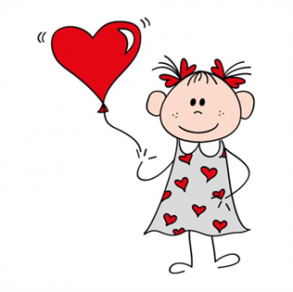
Friendship through play at Ebbegarden Nursery School.
Our project and prosess.

Slide 2
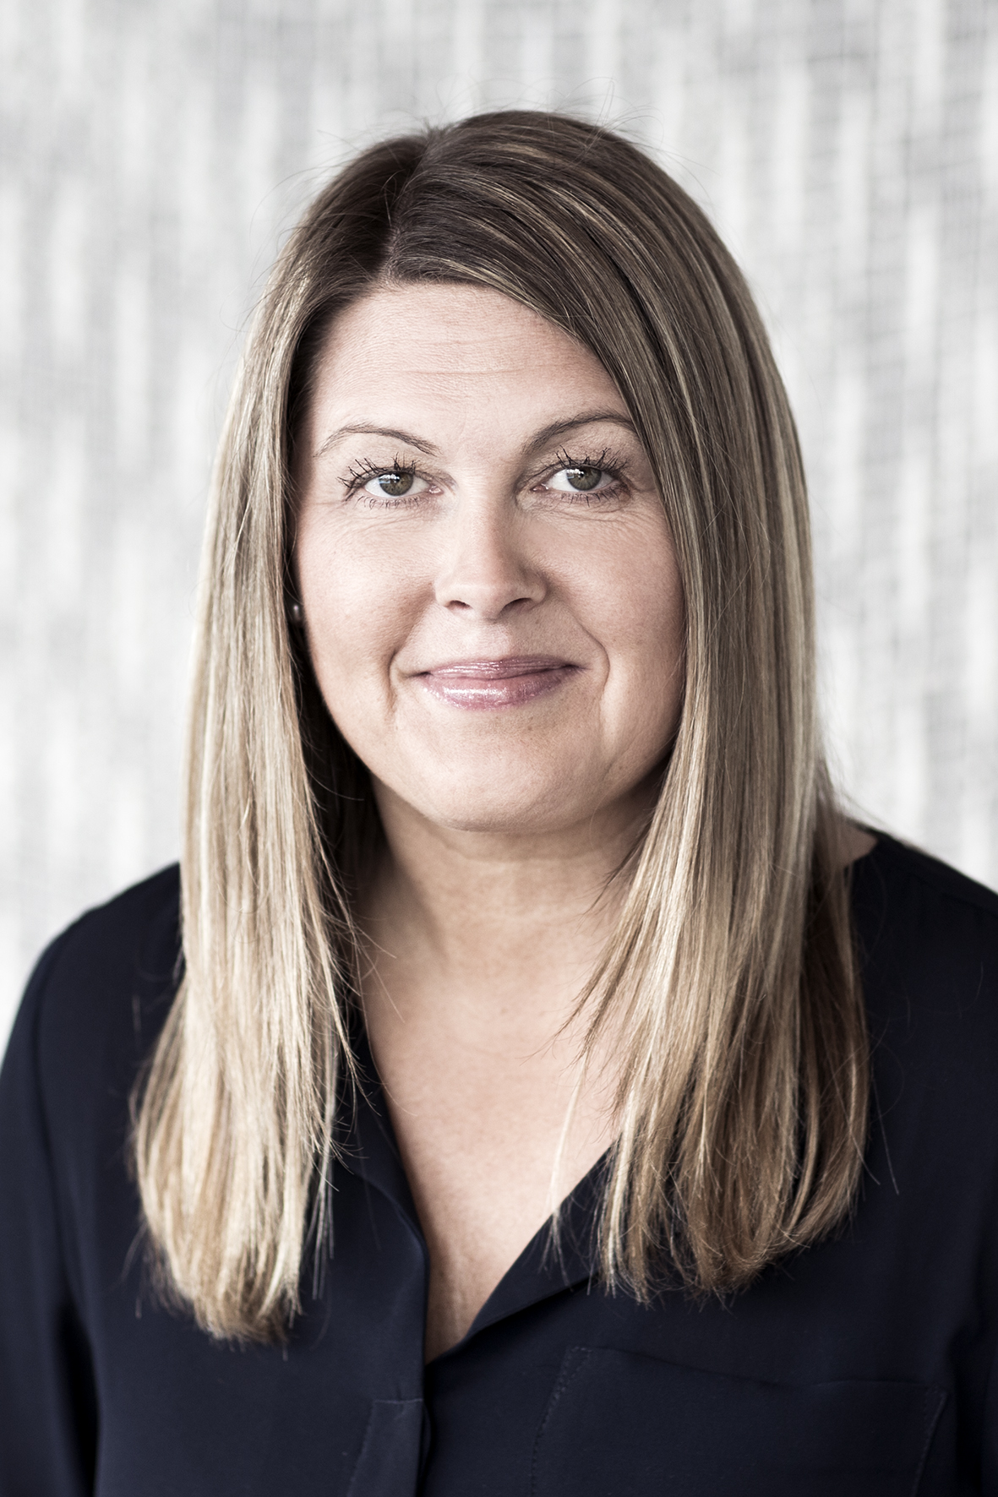
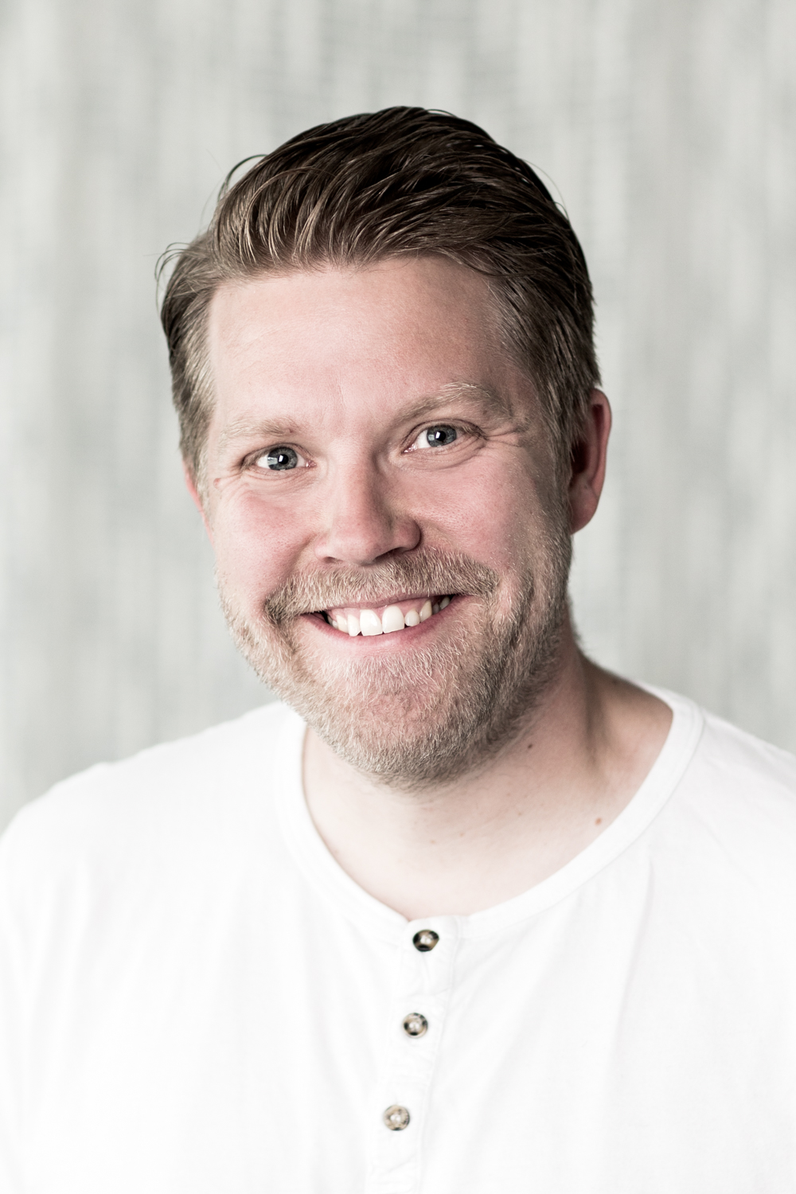
Welcome
Sølvi Smoge Solevågseide –director of Ebbegarden nursery school.
Dagfinn Bakkløkken – preschool teatcher in Ebbegarden nursery school and works with the oldest children who are 5-6 years.
  Was the leader of the group for this project.
  There were six employees with differnt education in this group who were running this project, including the director.

Slide 3
What is Ebbegarden Nursery School?
A private preschool, owned by the parents.
Opened February 2004
Staff of 31.
  11 bachelor degree or higher.
  7 high school degree.
Located at Emblem. Easy access to both sea, forests and mountains.

Slide 4
Ebbegarden Nursery School:
«a place where I become me.»
We want every child to feel important, to be seen and heard and allowed to be themselves.
The staff supports every child to be the best version of themselves as they can be.
This idea of how to meet every child is the foundation of everything we do, including the friendship though play project.

Slide 5
Getting started
A tradition of theme-based work.
The last theme we worked with, was play.
Coherence between our intended theme, and the theme set by the community.
Chose «the caretakers role» as our main focus.
Setting our research question, was done by the leader, based on the staffs wishes.
The research question was approved by the project managers.

Slide 6
What values do the staff wish to pass on to each child, so that they can make new friendships?
Multiple part question.
  What values are important?
  How to pass them on?
  How to reach every child?
  What contributes to making new friends?
To answer these we used I.G.P. discussion (Individual, Group, Plenary session).
A progress plan was made and submitted to the project managers.

Slide 7
The prosess
Got inspired by lectures provided by the project management, through workshops and discussion with other preschools, our own experiences and research and articles.
The progress plan was a working document. Some things were tested and refused, some things were added and the things that worked are still in use.
Dual focus.
  The children – what do they need to know?
  The staff – how to make them better?

Slide 8
The children
Create «the feeling of us».
Teach emotions and actions that build relationships
Observation and documentation.
Create a common social guideline.
  Low number of points
  Positive formulation
  Both strictly and generally.
«The bench of friendship» and «the door of hearts»

Slide 9
The staff
Knowledge of children.
  Increased focus on the child's wellbeing, through repeated observation and discussion among the team.
  Science theory input from conferences and literature.
Dedicated time at most meetings to discuss and address the project.
Homework and speed workshops
  Case. Make up a fictional case on a common issue
  Canvas. A statement/discussion tool.
  Observation stories. Be on the lookout for a story, write it down and discuss it with your co-workers.

Slide 10
Link to Bukowski og Abecassis kurve
  http://slideplayer.no/slide/12309160/73/images/3/Bukowski+%26+Abecassis+2007+Ulike+elevkategorier.jpg
Pål Rolands exclusion of psychological mechanisms
  http://slideplayer.no/slide/12309160/73/images/5/Utestengning+psykologiske+mekanismer.jpg

Slide 11
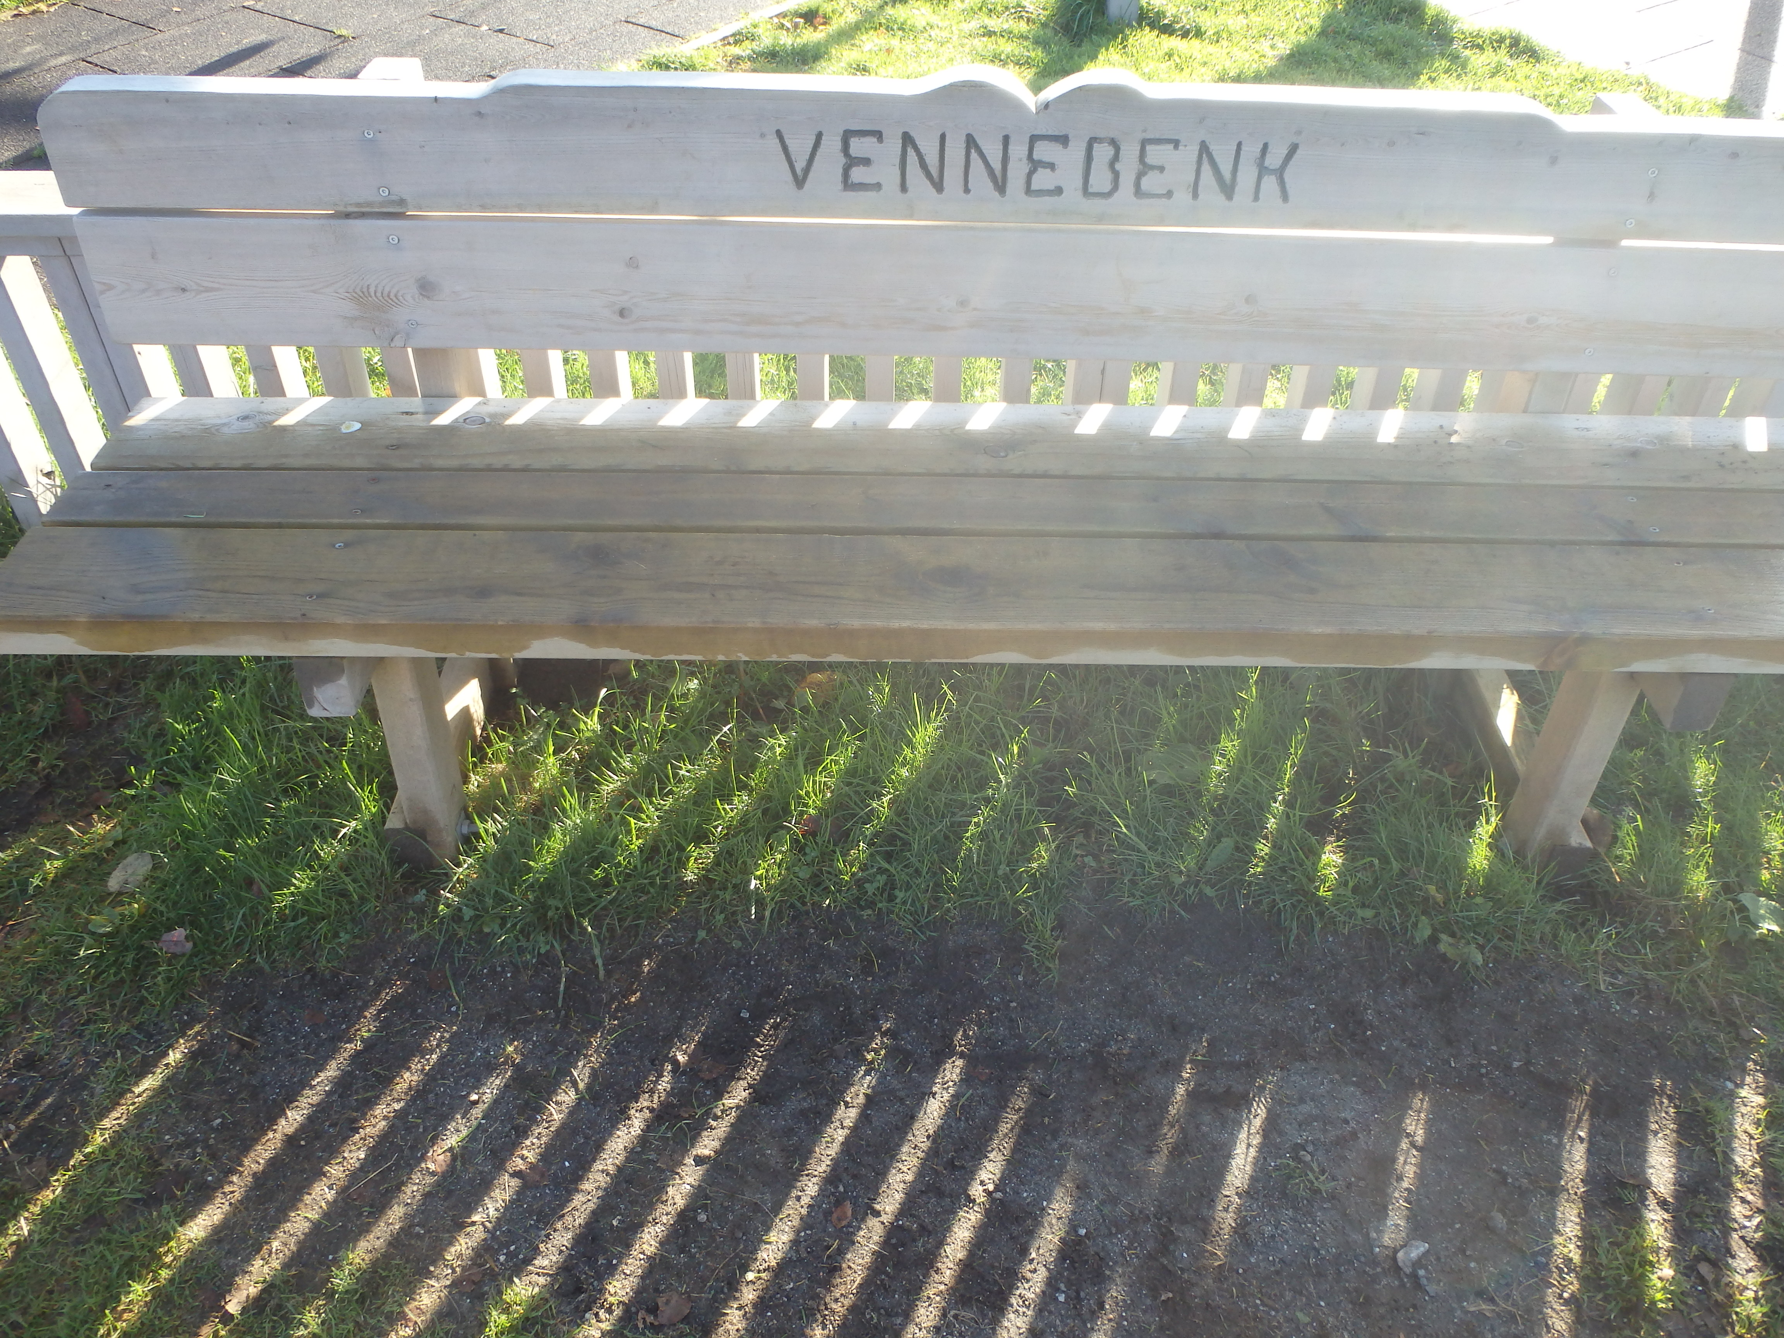
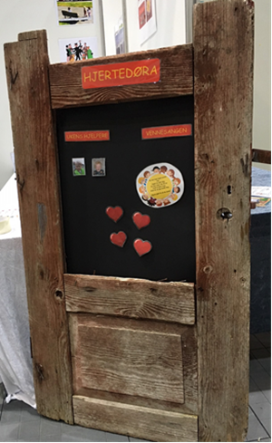
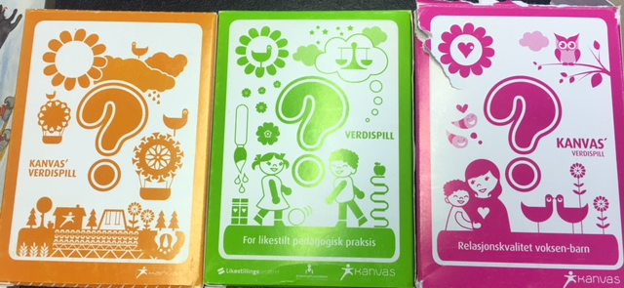
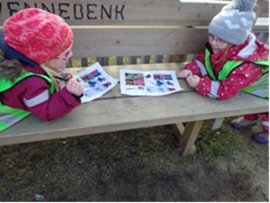

Slide 12
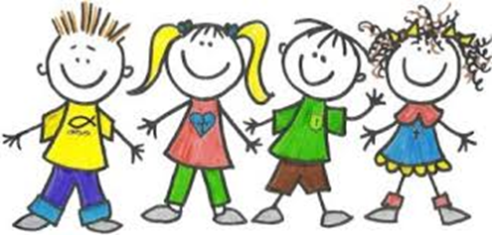
Thank you for your attention

